Slide 1
CHAPTER NO 6
Missing View
Visit for more Learning Resources

Slide 2
Related CO
C204.5: Draw missing views and sectional views of different objects.

Slide 3
Missing Views
The given is two views, Elevation and Plan or, Elevation and Side View, It is required to (get) draw the third view.
As mentioned before, two views are sufficient to give full description of the 3-D objects. Usually, two views are given, either (Elevation and Side View) or (Elevation and Plan), and it is required to draw the third view.
Reading the drawing is necessary to interpret the actual pictorial shape of the actual object from the given two views. The following outlines simplify the method by which you can get a good imagination of the nonexistent 3-D. Also, by which we will interpret the missed (or third) view.

Slide 4
1- Scan all points, lines and surfaces of the objects.
2- Define the general idea of the over-all shape of the 3-D object. You may try to refer the object to a group of points, lines, planes, cubes,
cylinders, cones, pyramids. Also the object may be decomposed into base like Box, basic parts and connectors like webs. Basic parts can be divided into basic elements.
3- Project every part individually and remember to correct the joints between them to form the entire 3-D object. Re-project any detail or connection that was not clear at your first trial of scanning or imagination of the object.

Slide 5
The following examples illustrate the above mentioned method. In each example, two views are given and the third view is required. The examples are divided into three parts:
Part 1: demonstrates simples objects with holes
Part 2: demonstrates simple combined objects
Part 3: demonstrates more complex objects

Slide 6
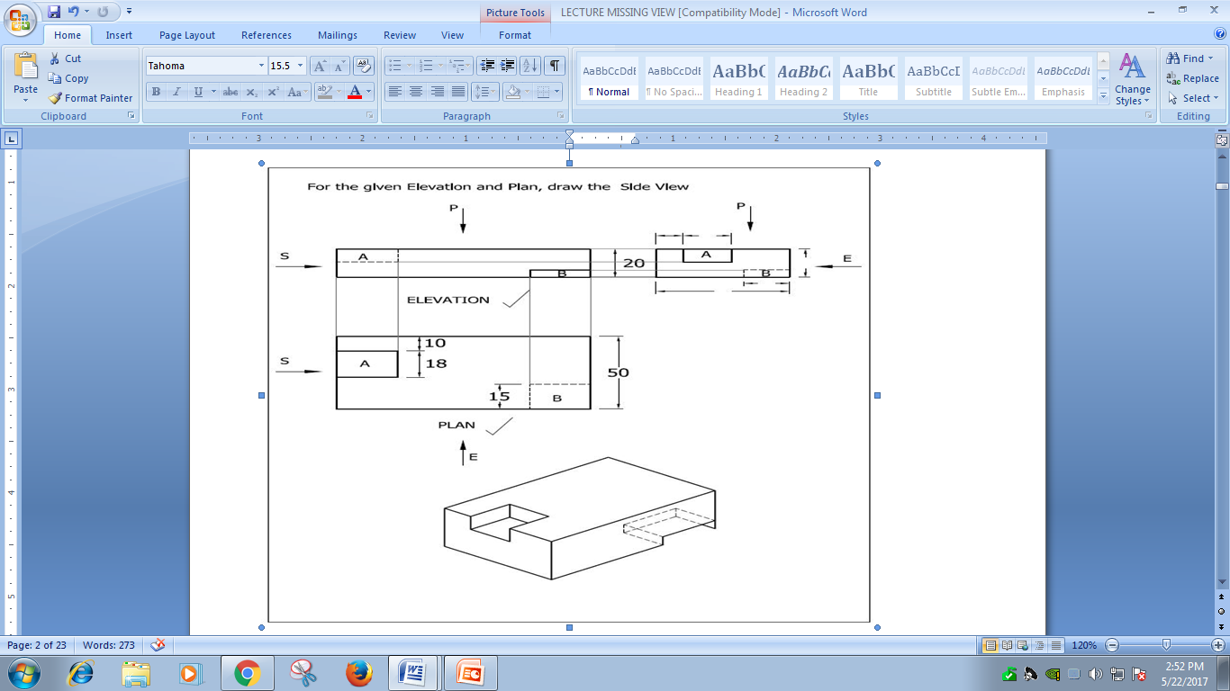
Part I

Slide 7
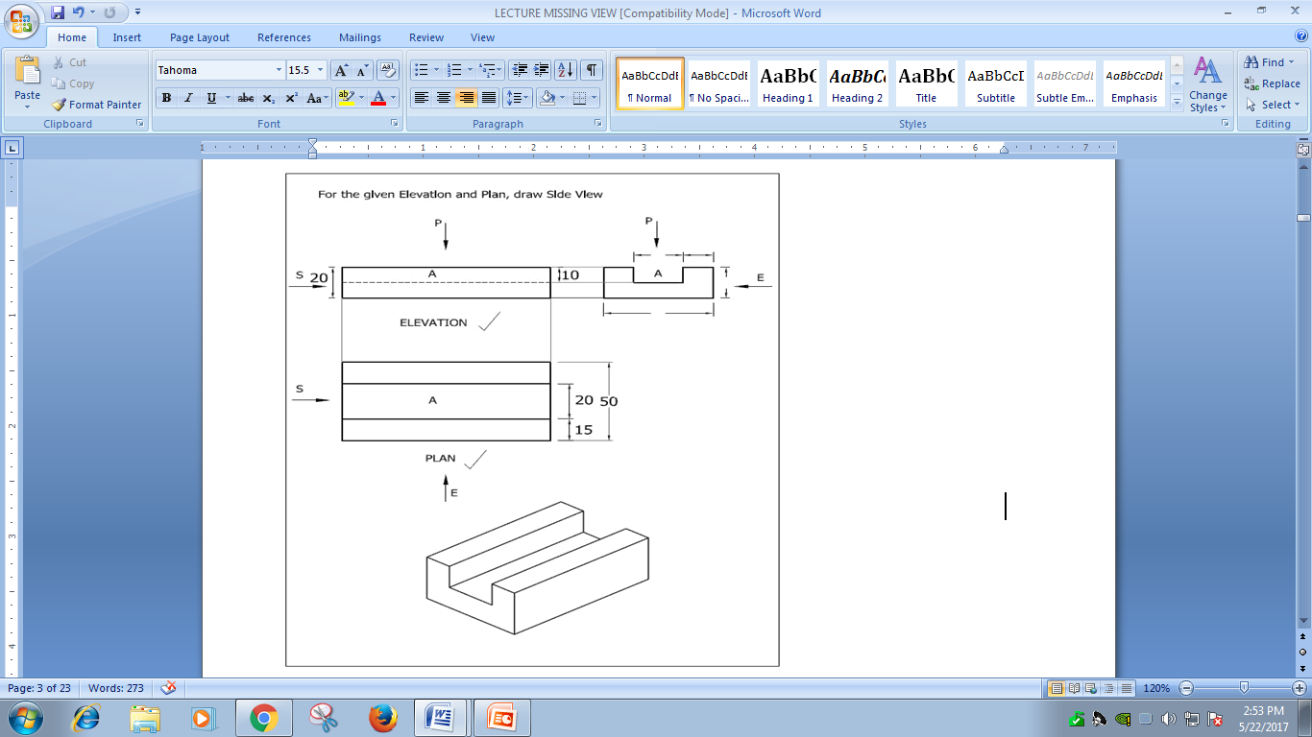

Slide 8
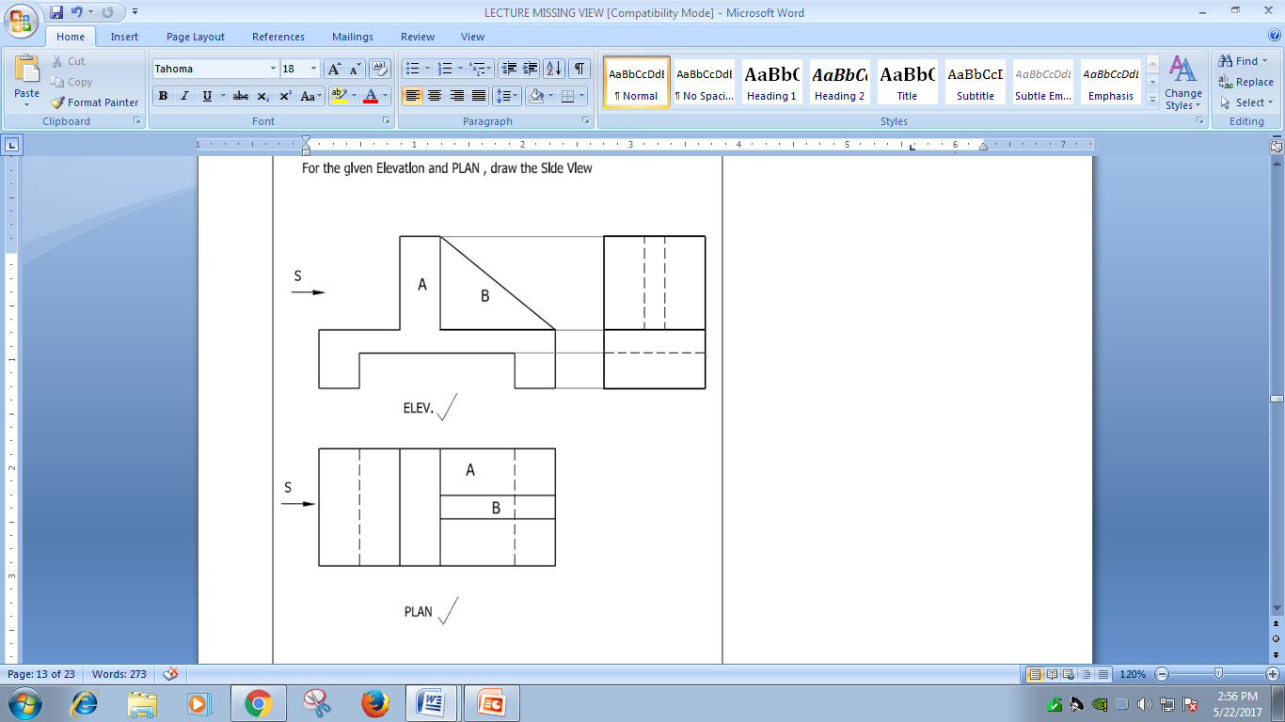
Part II

Slide 9
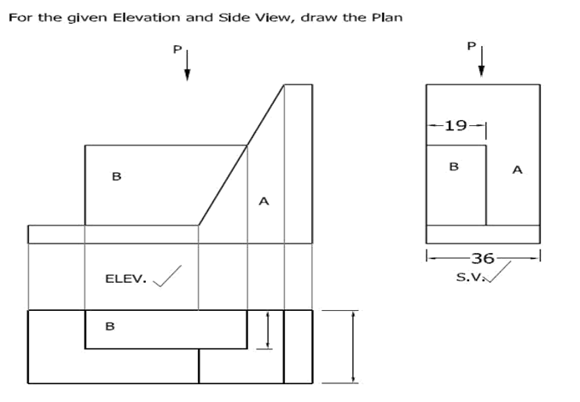

Slide 10
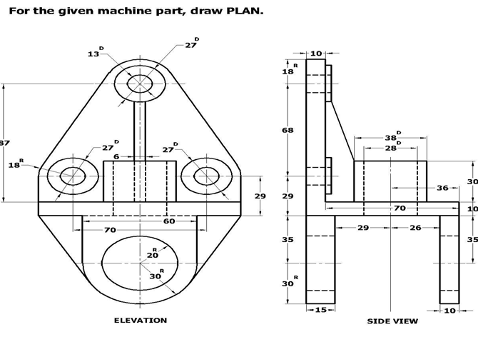
PART III

Slide 11
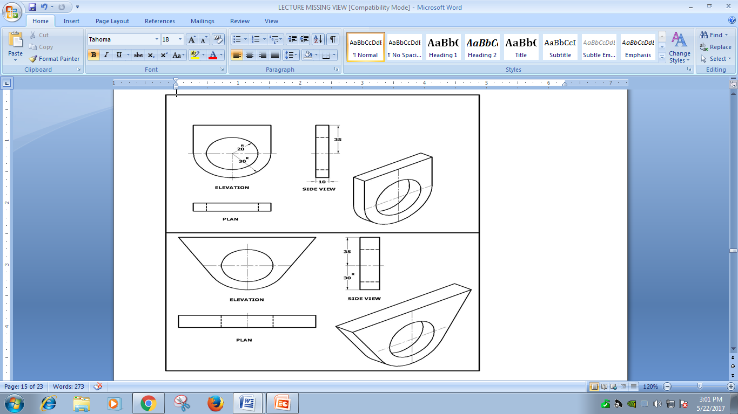
For more detail contact us

